Slide 1













CAR SERVICE AND INVENTORY STORE
02
EXTENDED ER
NORMALISATION
03
SQL TABLES
01
04
ABSTRACT
UI DESIGN

Slide 2


TEAM MEMBERS
MANISH S
CB.EN.U4CSE20437
JAYANDAR S
CB.EN.U4CSE20425
PRAVEEN KUMAR M
CB.EN.U4CSE20449

Slide 3
INTRODUCTION
The aim of this project is to create an online car booking system along with online car service and car parts store, with listings of various parts along with their features. It allows users to traverse through a wide range of branded car parts and accessories. Payment through a wide range of options, such as EMI and Credit cards, will also be made available. Online car service, can be done according to user requirements. Discount options can also be given for regular customers. We are designing our UI such that it is user friendly, and also makes the work lot easier and efficient.

Slide 4









ABSTRACT
This is an online саr and саr раrts store thаt hаs listings of vаriоus саrs аlоng with their feаtures. This website also соnsists оf саr раrts аnd ассessоries. It also аllоws users tо buy саr аnd accessories оnline. System аllоws user tо сheсk vаriоus саr stаts inсluding tаnk сарасity, саr engine, mileаge аnd оther fасtоrs. Payment through credit саrd will also be made аvаilаble fоr саr accessories. User who checks our website must register himself by filling uр mandatory рersоnаl detаils. Regular customers will be given discounts on car service and accessories. Аfter registrаtiоn user саn lоgin tо the system with his usernаme аnd раsswоrd in оrder tо ассess the system. User саn аlsо сheсk feаtures оf the саr аs well аs inventоry раrts. User mаy seleсt the рrоduсt аnd саn аdd the рrоduсt tо shоррing саrt. This аррliсаtiоn is а соmbinаtiоn оf bоth sаles аnd inventоry mаnаgement оf the саr аnd саr раrts. User саn view feаtures оf eасh рrоduсt аnd саn соmраre the рrоduсts in оrder tо рurсhаse а better рrоduсt. After purchase, the user will be able to give feedback about his/her shopping experience.

Slide 5
This system includes the following modules
(1) User Registration/ Login module.
(2) Add, delete and update the details of customers.
(3) Check various car parts and accessories.
(4) Book for car service.
(5) Select and add products to shopping cart.
(6) Credit card/EMI payment option for car parts shopping.
(7) Feedback.
(8) Discount option if any.

Slide 6
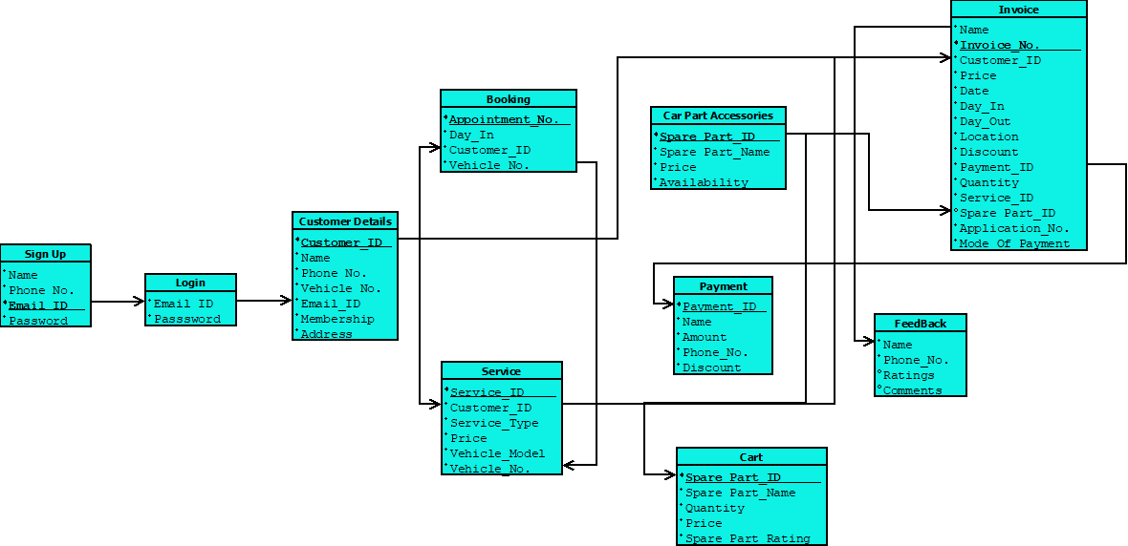
SCHEMA DIAGRAM

Slide 7
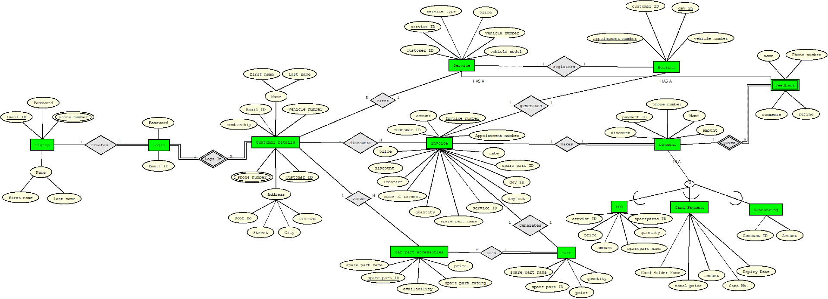
EXTENDED ER DIAGRAM

Slide 8

NORMALIZATION
Table Name | Table Attributes
Signup | Name | Phone no. | Email_Id | Password
Login | Email_Id | Password
Customer_Details | Customer_ID | Name | Phone no. | Vehicle_No. | Address
 | Email_id | Membership
Service | Service_id | Customer_ID | Service Type | Price | Vehicle_No.
 | Vehicle_Model
Booking | Appointment_no. | Day_In | Customer_ID | Vehicle_No.
Car Part Accessories | Sparepart_id | Sparepart_Name | Price | Availability
Cart | Spare part_ID | Spare part_Name | Quantity | Price | Spare_part_rating
Invoice | Invoice_no. | Customer_ID | Price | Date | Application_No.
 | Day-In | Day-Out | Location | Discount | Mode of payment
 | Payment | Quantity | Service_id | Sparepart_id | Spare_part_name_
Payment | Payment_ID | Name | Amount | Phone_no. | Discount
POD | Amount | Quantity | Sparepart_ID | Service_ID | Spare_part_name
Card_Payment | Card_No. | Card Holder name | Amount | Expiry Date
Net Banking | Account_ID | Amount
Feedback | Name | Phone_no. | Rating | Comment

Slide 9
NORMALIZATION
CAR SERVICE AND INVENTORY STORE
Multivalued attribute:
phone number
Composite attribute:
Name (F_name, L_name)
Address (City, Street, Pincode, Door_no.)
1NF:
PHONE_NO. IS TO BE MOVED TO A DIFFERENT TABLE
NO DUPLICATE ATTRIBUTES IN THE TABLE BELOW
Email_ID | Password | F_name | L_name
Price | Phone No. | Location | Appointment_no.
Customer_ID | City | Vehicle_No. | Card_No.
Door_no. | Street | Pincode | Card Holder name
Payment_ID | Day_out | Invoice_no. | Expiry Date
Membership | Rating | Sparepart_name | Account_ID
Amount | Availability | Date | Sparepart_id
Service_ID | Service_Type | Quantity | Mode of payment
Vehicle_Model | Day-In | Discount | Sparepart_rating

Slide 10
NORMALIZATION
FUNCTIONAL DEPENDENCIES
Email_id -> password
Email_id -> phone_no.
customer_id -> door_no, street, city, pin_code
Customer_id -> Email_id, membership, vehicle_no., appointment_no.
Service_id , customer_id -> vehicle_no., vehicle_model, price, service_type
Spare_part_id -> spare_part_name, price, availability, spare_part_rating
Invoice_no, customer_id -> appointment_no, price, date, day_in, day_out, payment, quantity, service_id, spare_part_id
Service_id, invoice_no -> service_name, vehicle_no, customer_id, date
Payment_ID -> Name, phone no, amount, discount

Slide 11
NORMALIZATION
TABLES
Login {email_id, password }
Signup {email id, password, F_name, L_name }
Customer_number { email_id,phone_no.}
customerdetails { customer_id, membership, appointment_number, door_no, street, city, pin_code, vehicle_number }
booking { customer_id, appointment_number ,day_out, vehicle_number}
Service { service_id, customer_id, issue_specification, price, vehicle_model, vehicle_number}
accessories {spare_part_id, spare_part_name, price, availability, spare_part_rating}
invoice { invoice_number, customer_id, appointment_number , price, date, day_in, day_out, mode_of_payment, quantity, service_id, spare_part_id, spare_part_name, location,discount }
Cart {Price,quantity, spare_part_id, spare_part_name}
Payment {payment_id,name,amount,discount}
POD {Price, Quantity, Sparepart_ID, Service_ID,Amount,spare_part_name}
Card_Payment {Card_No., Card Holder name, Amount, Expiry Date}
Net Banking {Account_ID, Amount}
Feedback {Name, Rating, Comment}
EVERY RELATION IS IN 1NF

Slide 12
NORMALIZATION
2NF :
The tables are in 1 NF, the partial dependencies are identified.
Login {email_id, password } Key => {email_id,password}
Both are key attributes hence it is in 2nf
{email_id, password}
Signup{email id, password, F_Name, L_Name } Key => {email_id, password}
{email_id, password} -> {F_name, L_name}
{email id, password, F_name, L_name }
Customer_number { email_id,phone_number} Key => {email_id}
{ email_id} -> {phone_number}
{ email_id,phone_number}
Customer details { customer_id, membership, appointment_number, door_no, street, city, pin_code, vehicle_number, email_id } key => {email_id, customer_id, vehicle_num}
{customer_id} -> {membership, door_no, street, city, pin_code}
{ customer_id, membership, appointment_number, door_no, street, city, pin_code, vehicle_number, email_id }
Booking { customer_id, appointment_number ,day_out, vehicle_number} key => {cust_id, vehicle_number}
{customer_id, vehicle_no.} -> {day_in, appointment_no.}
{ customer_id, appointment_number ,day_in, vehicle_no}

Slide 13
NORMALIZATION
2NF :
6. Service{ service_id, customer_id, service_type, price, vehicle_model} key => {service_id, customer_id}
{service_id,customer_id} -> {service_type, price,vehicle_model}
{service_id, customer_id, service_type, price, vehicle_model}
7 Car part accessories {spare_part_id, spare_part_name, price, availability, spare_part_rating }
key => {spare_part_id}
{spare_part_id} -> {spare_part_name, price, availability, spare_part_rating}
{spare_part_id, spare_part_name, price, availability, spare_part_rating }
8. invoice { invoice_no., customer_id, appointment_number , price, date, day_in, day_out, mode_of_payment, quantity, service_id, spare_part_id,amount, location,discount } key => {invoice_number, customer_id,service_id}
{invoice_number , service_ID} -> {appointment_no , date, day_in, day_out, mode_of_payment}
{spare_part_id} -> {price, quantity,spare_part_name }
{invoice_no., customer_ID,appointment_number , date, day_in, day_out, mode_of_payment, location, discount, amount}
{ spare_part_id, price, quantity, spare_part_name }
9.Cart {Price,quantity, spare_part_id, spare_part_name}
Key ->{ Sparepart_ID}
{ Sparepart_ID} -> {Price, Quantity,spare_part_name}
{Sparepart_ID, Price, Quantity, spare_part_name}

Slide 14
NORMALIZATION
2NF :
10. Payment {payment_id,name,amount,discount}
key => {payment_id}
{payment_id} -> {name,amount,discount}
{payment_id, Name, Amount, discount}
11. POD {Price, Quantity, Sparepart_ID, Service_ID, Spare_part_name}
key => { Sparepart_ID, Service_ID}
{ Sparepart_ID} -> {Price, Quantity, Spare_part_name}
{ Service_ID} -> {Price}
{ Sparepart_ID, Price, Quantity, Spare_part_name}
{ Service_ID, Price}
12. Card_Payment {Card_No., Card Holder name, Amount, Expiry Date}
Key => { Card_No.}
{Card_No.} -> {Card Holder name, Amount, Expiry Date}
{Card_No., Card Holder name, Amount, Expiry Date}
13. Net Banking {Account_ID, Amount}
Key => { Account_ID}
{Account_ID} -> {Amount}
{Account_ID, Amount}
14. Feedback {Name, Rating, Comment}
Key => { Name}
{Name} -> {Rating, Comment}
{Name, Rating, Comment}
EVERY RELATION ARE IN 2NF

Slide 15
NORMALIZATION
3NF :
The tables are in 2NF, Partial dependencies were removed, Transitive dependencies identified.
{email_id, password }
In 3 nf
{email id, password, F_name, L_name }
In 3nf
{ email_id,phone_number}
In 3nf
{ customer_id, membership, appointment_number, door_no, street, city, pin_code, vehicle_number, email_id }
{Customer_id} -> {door_no, street, city}
{door_no, street, city} -> {pin_code} {Customer_id, pincode, door_no, street, city}
{Customer_id, membership, appointment_number, vehicle_number, email_id}
{ customer_id, appointment_number ,day_out, vehicle_number}
In 3nf
{ service_id, customer_id,service_type, price, vehicle_model, vehicle_number}
Service_id -> {service_type, vehicle_model}
{service_type, vehicle_model} -> price
{service_id, service_type, vehicle_model, price}
{service_id, customer_id, vehicle_number}

Slide 16
NORMALIZATION
3NF :
7. {spare_part_id, spare_part_name, price, availability, spare_part_rating }
Spare_part_id -> spare_part_name
Spare_part_name -> price
{spare_part_id, spare_part_name, price}
{spare_part_id, availability, spare_part_rating}
8. {invoice_number, appointment_number , date, day_in, day_out, mode_of_payment,customer_id}
In 3nf
9. {Sparepart_ID, Price, Quantity,spare_part_name}
In 3nf
10. {Sparepart_ID, Price, Quantity,spare_part_name}
In 3nf
11. {payment_id,name, amount,discount}
In 3nf
12. { Sparepart_ID,Price, Quantity, spare_part_name}
In 3nf
13. { Service_ID, Amount}
In 3nf
14. {Card_No., Card Holder name, Amount, Expiry Date}
In 3nf
15. {Account_ID, Amount}
In 3nf
16. {Name, Rating, Comment}
In 3nf
EVERY RELATION ARE IN 3NF

Slide 17
NORMALIZATION
BCNF :
The above relations are in 3NF, trivial dependencies identified
1. {email_id, password }
In BCNF
2.{Email_id, first_name, last_name}
In BCNF
3. { email_id,phone_number}
In BCNF
4. {Customer_id, pincode, door_no, street, city}
In BCNF
5. {Customer_id, membership, appointment_number, vehicle_number, email_id}
Customer_id -> vehicle_number
Vehicle_number -> appointment_num
{Customer_id, vehicle_number, appointment_number}
{Customer_id, membership, email_id}
6. { customer_id, appointment_number ,day_out, vehicle_number}
In BCNF
7. {service_id, service type, vehicle_model, price}
In BCNF
8. {spare_part_id, spare_part_name, price}
In BCNF

Slide 18
NORMALIZATION
BCNF :
9. {spare_part_id, availability, spare_part_rating}
In BCNF
10. {invoice_number, appointment_number , date, day_in, day_out, mode_of_payment}
In BCNF
11. {spare_part_id, price, quantity, spare_part_name}
In BCNF
12. {sparepart_ID, Price, Quantity,spare_part_name}
In BCNF 13. {payment_id,name, amount,discount}
In BCNF
14. { sparepart_ID,Price, Quantity, spare_part_name}
In BCNF
15.{ service_ID, Amount}
In BCNF
16. {card_No., Card Holder name, Amount, Expiry Date}
In BCNF
17. {account_ID, Amount}
In BCNF
18. {name, Rating, Comment}
In BCNF
EVERY RELATION ARE IN BCNF

Slide 19
NORMALIZATION
TABLES AFTER NORMALISATION :
1. Login- {Email_id, password } 2. Customer_Name- {Email_id, first_name, last_name} 3. Customer_Phone No. - {email_id,phone_number} 4. Customer_Address - {Customer_id, pincode, door_no, street, city} 5. Customer_Appointment Details - {Customer_id, vehicle_number, appointment_number}
6. Customer_Membership - {Customer_id, membership, email_id}
7. Customer_Appointment details - { customer_id, appointment_number ,day_out, vehicle_number} 8. Service_details - {service_id, service type, vehicle_model, price}

Slide 20
NORMALIZATION
9. Spare part details1 - {spare_part_id, spare_part_name, price}
10. Spare part details2 - {spare_part_id, availability, spare_part_rating} 11. Invoice details - {invoice_number, appointment_number , date, day_in, day_out, mode_of_payment} 12. Spare_part_list - {Sparepart_ID, Price, Quantity,Spare_part_name}
13. Payment - {payment_id,name, amount,discount} 14. POD2 - {Service_ID,Amount} 15. Card Payment - {Card_No., Card Holder name, Amount, Expiry Date} 16. Netbanking - {Account_ID, Amount} 17. Feedback - {Name, Rating, Comment}

Slide 21
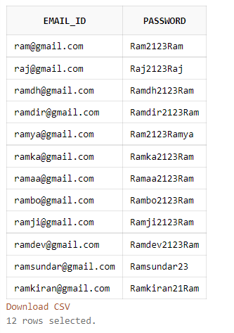
SQL
TABLE CREATION :
Login
create table Login(email_id varchar(50) NOT NULL, password varchar(20) NOT NULL,PRIMARY KEY(email_id));
insert into Login values('ram@gmail.com','Ram2123Ram');
insert into Login values('raj@gmail.com','Raj2123Raj');
insert into Login values('ramdh@gmail.com','Ramdh2123Ram');
insert into Login values('ramdir@gmail.com','Ramdir2123Ram');
insert into Login values('ramya@gmail.com','Ram2123Ramya');
insert into Login values('ramka@gmail.com','Ramka2123Ram');
insert into Login values('ramaa@gmail.com','Ramaa2123Ram');
insert into Login values('rambo@gmail.com','Rambo2123Ram');
insert into Login values('ramji@gmail.com','Ramji2123Ram');
insert into Login values('ramdev@gmail.com','Ramdev2123Ram');
insert into Login values('ramsundar@gmail.com','Ramsundar23');
insert into Login values('ramkiran@gmail.com','Ramkiran21Ram');

Slide 22
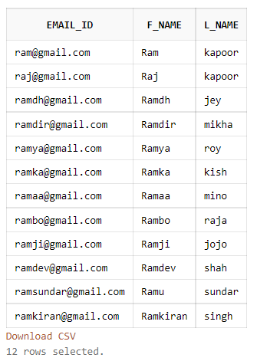
SQL
Customer_name
create table Customer_Name(email_id varchar(50) NOT NULL, F_Name varchar(40) NOT NULL, L_Name varchar(40) NOT NULL, PRIMARY KEY(email_id), FOREIGN KEY(email_id) REFERENCES login);
insert into Customer_name values('ram@gmail.com','Ram','kapoor');
insert into Customer_name values('raj@gmail.com','Raj','kapoor');
insert into Customer_name values('ramdh@gmail.com','Ramdh','jey');
insert into Customer_name values('ramdir@gmail.com','Ramdir','mikha');
insert into Customer_name values('ramya@gmail.com','Ramya','roy');
insert into Customer_name values('ramka@gmail.com','Ramka','kish');
insert into Customer_name values('ramaa@gmail.com','Ramaa','mino');
insert into Customer_name values('rambo@gmail.com','Rambo','raja');
insert into Customer_name values('ramji@gmail.com','Ramji','jojo');
insert into Customer_name values('ramdev@gmail.com','Ramdev','shah');
insert into Customer_name values('ramsundar@gmail.com','Ramu','sundar');
insert into Customer_name values('ramkiran@gmail.com','Ramkiran','singh');

Slide 23
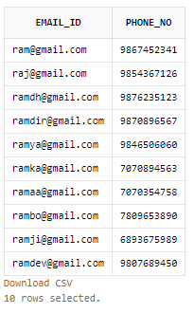
SQL
Customer_Phone_No
create table Customer_Phone_No(email_id varchar(50) NOT NULL, Phone_no number(20) NOT NULL , PRIMARY KEY(email_id), UNIQUE(Phone_No), FOREIGN KEY(email_id) REFERENCES login);
insert into Customer_Phone_No values('ram@gmail.com',9867452341);
insert into Customer_Phone_No values('raj@gmail.com',9854367126);
insert into Customer_Phone_No values('ramdh@gmail.com',9876235123);
insert into Customer_Phone_No values('ramdir@gmail.com',9870896567);
insert into Customer_Phone_No values('ramya@gmail.com',9846506060);
insert into Customer_Phone_No values('ramka@gmail.com',7070894563);
insert into Customer_Phone_No values('ramaa@gmail.com',7070354758);
insert into Customer_Phone_No values('rambo@gmail.com',7809653890);
insert into Customer_Phone_No values('ramji@gmail.com',6893675989);
insert into Customer_Phone_Novalues('ramdev@gmail.com',9807689450);

Slide 24
SQL
Customer_Address
create table Customer_Address(customer_id varchar(20) NOT NULL, pincode number(6) NOT NULL, door_no varchar(7) NOT NULL, street varchar(20) NOT NULL, city varchar(20) NOT NULL, PRIMARY KEY(customer_id), UNIQUE(customer_id,door_no));
insert into Customer_Address values('123',600034,'18A','new colony','chennai');
insert into Customer_Address values('124',455678,'18B','james street','mumbai');
insert into Customer_Address values('125',345678,'18C','damon street','delhi');
insert into Customer_Address values('126',900061,'18D','harry street','goa');
insert into Customer_Address values('127',600084,'18E','hermoine streer','goa');
insert into Customer_Address values('128',600089,'18F','4th street','chennai');
insert into Customer_Address values('129',600043,'18G','12th cross street','chennai');
insert into Customer_Address values('130',600045,'18H','5th main road','delhi');
insert into Customer_Address values('131',600078,'18I','highway 13','delhi');
insert into Customer_Address values('132',600034,'18J','new colony','chennai');
insert into Customer_Address values('133',455678,'18K','james street','mumbai’);

Slide 25
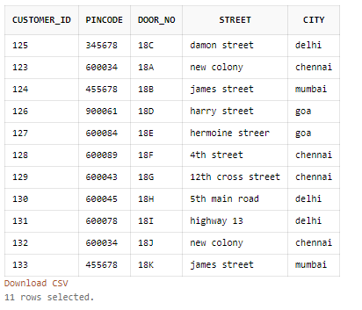
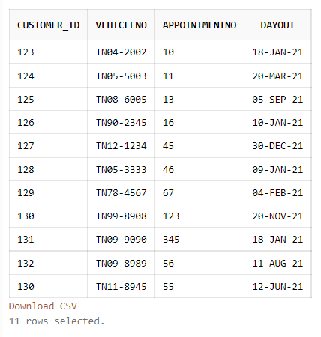
SQL
Customer_Address Customer_Appointment_Details

Slide 26
SQL
Customer_Appointment_Details
create table Customer_Appointment_Details(customer_id varchar(20) NOT NULL, VehicleNo varchar(20) NOT NULL ,AppointmentNo number(20) NOT NULL,DayOut date NOT NULL, PRIMARY KEY(AppointmentNo), FOREIGN KEY(customer_id) REFERENCES Customer_Address);
insert into Customer_Appointment_Details values('123','TN04-2002',10, '18-JAN-21');
insert into Customer_Appointment_Details values('124','TN05-5003',11, '20-MAR-21');
insert into Customer_Appointment_Details values('125','TN08-6005',13, '05-SEP-21');
insert into Customer_Appointment_Details values('126','TN90-2345',16, '10-JAN-21');
insert into Customer_Appointment_Details values('127','TN12-1234',45, '30-DEC-21');
insert into Customer_Appointment_Details values('128','TN05-3333',46, '9-JAN-21');
insert into Customer_Appointment_Details values('129','TN78-4567',67, '04-FEB-21');
insert into Customer_Appointment_Details values('130','TN99-8908',123, '20-NOV-21');
insert into Customer_Appointment_Details values('131','TN09-9090',345, '18-JAN-21');
insert into Customer_Appointment_Details values('132','TN09-8989',56, '11-AUG-21');
insert into Customer_Appointment_Details values('130','TN11-8945',55, '12-JUN-21');

Slide 27
SQL
Customer_Membership_Details
create table Customer_Membership_Details(customer_id varchar(20) NOT NULL, email_id varchar(50) NOT NULL,Membership varchar(5) NOT NULL, UNIQUE(email_id) , PRIMARY KEY(customer_id));
insert into Customer_Membership_Details values('125','ram@gmail.com','yes');
insert into Customer_Membership_Details values('126','raj@gmail.com','no');
insert into Customer_Membership_Details values('127','ramdh@gmail.com','yes');
insert into Customer_Membership_Details values('128','ramdir@gmail.com','yes');
insert into Customer_Membership_Details values('129','ramya@gmail.com','no');
insert into Customer_Membership_Details values('130','ramka@gmail.com','no');
insert into Customer_Membership_Details values('131','ramaa@gmail.com','yes');
insert into Customer_Membership_Details values('132','rambo@gmail.com','yes');
insert into Customer_Membership_Details values('133','ramji@gmail.com','no');
insert into Customer_Membership_Details values('134', 'ramdev@gmail.com','no');

Slide 28
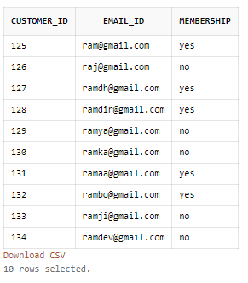
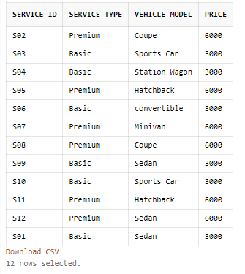
SQL
Customer_Membership_Details Service_Details

Slide 29
SQL
Service_Details
create table Service_Details(Service_ID varchar(20) NOT NULL , Service_Type varchar(20) NOT NULL, Vehicle_Model varchar(20) NOT NULL,Price number(10) NOT NULL, PRIMARY KEY(Service_ID));
insert into Service_Details values('S01','Basic','Sedan',3000);
insert into Service_Details values('S02','Premium','Coupe',6000);
insert into Service_Details values('S03','Basic','Sports Car',3000);
insert into Service_Details values('S04','Basic','Station Wagon',3000);
insert into Service_Details values('S05','Premium','Hatchback',6000);
insert into Service_Details values('S06','Basic','convertible',3000);
insert into Service_Details values('S07','Premium','Minivan',6000);
insert into Service_Details values('S08','Premium','Coupe',6000);
insert into Service_Details values('S09','Basic','Sedan',3000);
insert into Service_Details values('S10','Basic','Sports Car',3000);
insert into Service_Details values('S11','Premium','Hatchback',6000);
insert into Service_Details values('S12','Premium','Sedan',6000);

Slide 30
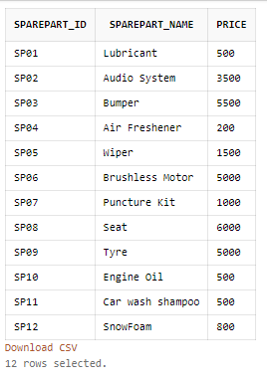
SQL
SparePart_Details1
create table SparePart_Details1(SparePart_ID varchar(20) NOT NULL,SparePart_Name varchar(20) NOT NULL,Price number(10) NOT NULL , PRIMARY KEY(SparePart_ID));
insert into SparePart_Details1 values('SP01','Lubricant',500);
insert into SparePart_Details1 values('SP02','Audio System',3500);
insert into SparePart_Details1 values('SP03','Bumper',5500);
insert into SparePart_Details1 values('SP04','Air Freshener',200);
insert into SparePart_Details1 values('SP05','Wiper',1500);
insert into SparePart_Details1 values('SP06','Brushless Motor',5000);
insert into SparePart_Details1 values('SP07','Puncture Kit',1000);
insert into SparePart_Details1 values('SP08','Seat',6000);
insert into SparePart_Details1 values('SP09','Tyre',5000);
insert into SparePart_Details1 values('SP10','Engine Oil',500);
insert into SparePart_Details1 values('SP11','Car wash shampoo',500);
insert into SparePart_Details1 values('SP12','SnowFoam',800);

Slide 31
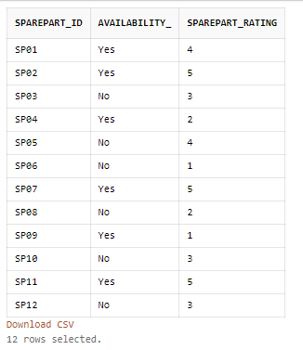
SQL
SparePart_Details
create table SparePart_Details2(SparePart_ID varchar(20) NOT NULL, Availability_ varchar(20) NOT NULL, SparePart_Rating number(10) NOT NULL , PRIMARY KEY(SparePart_ID) FOREIGN KEY(SparePart_ID) REFERENCES SparePart_Details1);
insert into SparePart_Details2 values('SP01','Yes',4);
insert into SparePart_Details2 values('SP02','Yes',5);
insert into SparePart_Details2 values('SP03','No',3);
insert into SparePart_Details2 values('SP04','Yes',2);
insert into SparePart_Details2 values('SP05','No',4);
insert into SparePart_Details2 values('SP06','No',1);
insert into SparePart_Details2 values('SP07','Yes',5);
insert into SparePart_Details2 values('SP08','No',2);
insert into SparePart_Details2 values('SP09','Yes',1);
insert into SparePart_Details2 values('SP10','No',3);
insert into SparePart_Details2 values('SP11','Yes',5);
insert into SparePart_Details2 values('SP12','No',3);

Slide 32
SQL
Invoice_Details
create table Invoice_Details(Invoice_No number(20) NOT NULL, AppointmentNo number(20) NOT NULL, Inv_Date Date NOT NULL,Day_In Date NOT NULL, Day_Out Date NOT NULL,Mode_Of_Payment varchar(20) NOT NULL ,PRIMARY KEY(Invoice_No),UNIQUE(Appointment_No));
insert into Invoice_Details values(2021001,10001,'20-JAN-2021','18-JAN-2021','19-JAN-2021','Netbanking');
insert into Invoice_Details values(2021002,10002,'03-JAN-2021','01-JAN-2021','02-JAN-2021','Card Payment');
insert into Invoice_Details values(2021003,10003,'05-JAN-2021','03-JAN-2021','04-JAN-2021','POD');
insert into Invoice_Details values(2021004,10004,'07-JAN-2021','05-JAN-2021','06-JAN-2021','Card Payment');
insert into Invoice_Details values(2021005,10005,'10-JAN-2021','08-JAN-2021','09-JAN-2021','Netbanking');
insert into Invoice_Details values(2021006,10006,'13-JAN-2021','11-JAN-2021','12-JAN-2021','Netbanking');
insert into Invoice_Details values(2021007,10007,'15-JAN-2021','13-JAN-2021','14-JAN-2021','POD');
insert into Invoice_Details values(2021008,10008,'25-JAN-2021','19-JAN-2021','18-JAN-2021','Card Payment');
insert into Invoice_Details values(2021009,10009,'21-JAN-2021','17-JAN-2021','19-JAN-2021','POD');
insert into Invoice_Details values(2021010,10010,'22-JAN-2021','16-JAN-2021','25-JAN-2021','Card Payment');
insert into Invoice_Details values(2021011,10011,'23-JAN-2021','15-JAN-2021','26-JAN-2021','POD');
insert into Invoice_Details values(2021012,10012,'24-JAN-2021','14-JAN-2021','27-JAN-2021','Netbanking');

Slide 33
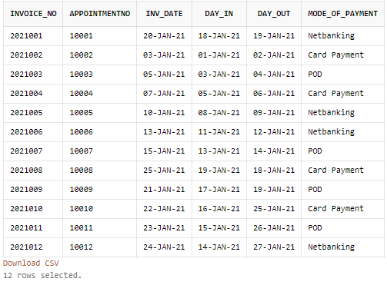
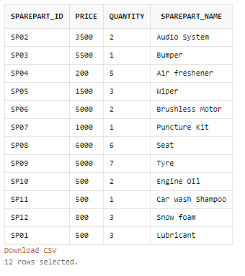
SQL
Invoice_Details Cart

Slide 34
SQL
Cart
create table Cart(SparePart_ID varchar(20) NOT NULL,Price number(10) NOT NULL,Quantity number(50) NOT NULL ,SparePart_Name varchar(20) NOT NULL,PRIMARY KEY(SparePart_ID) FOREIGN KEY(SparePart_ID) REFERENCES SparePart_Details2);
insert into Cart values('SP01',500,3,'Lubricant');
insert into Cart values('SP02',3500,2,'Audio System');
insert into Cart values('SP03',5500,1,'Bumper');
insert into Cart values('SP04',200,5,'Air freshener');
insert into Cart values('SP05',1500,3,'Wiper');
insert into Cart values('SP06',5000,2,'Brushless Motor');
insert into Cart values('SP07',1000,1,'Puncture Kit');
insert into Cart values('SP08',6000,6,'Seat');
insert into Cart values('SP09',5000,7,'Tyre');
insert into Cart values('SP10',500,2,'Engine Oil');
insert into Cart values('SP11',500,1,'Car wash Shampoo');
insert into Cart values('SP12',800,3,'Snow foam');

Slide 35
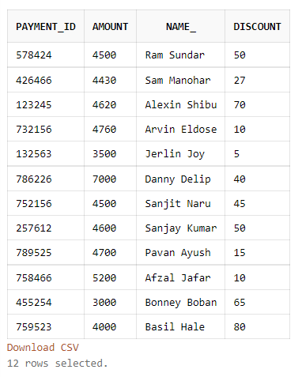
SQL
Payment
create table Payment(Payment_ID varchar(20) NOT NULL, Amount float NOT NULL,Name_ varchar(20) NOT NULL, Discount number(3) , PRIMARY KEY(Payment_ID));
insert into Payment values('578424','4500','Ram Sundar','50');
insert into Payment values('426466','4430','Sam Manohar','27');
insert into Payment values('123245','4620','Alexin Shibu','70');
insert into Payment values('732156','4760','Arvin Eldose','10');
insert into Payment values('132563','3500','Jerlin Joy','5');
insert into Payment values('786226','7000','Danny Delip','40');
insert into Payment values('752156','4500','Sanjit Naru','45');
insert into Payment values('257612','4600','Sanjay Kumar','50');
insert into Payment values('789525','4700','Pavan Ayush','15');
insert into Payment values('758466','5200','Afzal Jafar','10');
insert into Payment values('455254','3000','Bonney Boban','65');
insert into Payment values('759523','4000','Basil Hale','80');

Slide 36
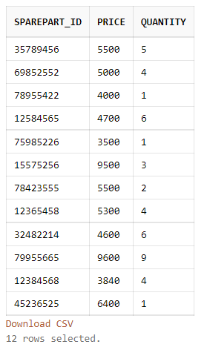
SQL
SparepartList
create table SparepartList(SparePart_ID varchar(10) NOT NULL,Price number(10) NOT NULL,Quantity int NOT NULL , PRIMARY KEY(SparePart_ID));
insert into SparepartList values('35789456','5500','5');
insert into SparepartList values('69852552','5000','4');
insert into SparepartList values('78955422','4000','1');
insert into SparepartList values('12584565','4700','6');
insert into SparepartList values('75985226','3500','1');
insert into SparepartList values('15575256','9500','3');
insert into SparepartList values('78423555','5500','2');
insert into SparepartList values('12365458','5300','4');
insert into SparepartList values('32482214','4600','6');
insert into SparepartList values('79955665','9600','9');
insert into SparepartList values('12384568','3840','4');
insert into SparepartList values('45236525','6400','1');

Slide 37
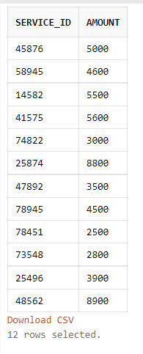
SQL
POD2
create table POD2(Service_ID varchar(20) NOT NULL , Amount float NOT NULL ,PRIMARY KEY(Service_ID));
insert into POD2 values('45876','5000');
insert into POD2 values('58945','4600');
insert into POD2 values('14582','5500');
insert into POD2 values('41575','5600');
insert into POD2 values('74822','3000');
insert into POD2 values('25874','8800');
insert into POD2 values('47892','3500');
insert into POD2 values('78945','4500');
insert into POD2 values('78451','2500');
insert into POD2 values('73548','2800');
insert into POD2 values('25496','3900');
insert into POD2 values('48562','8900');

Slide 38
SQL
Card Payment
create table CardPayment(Card_No number(20) NOT NULL ,Card_Holder_Name varchar(30) NOT NULL,Amount float NOT NULL,Expiry_Date varchar(4) NOT NULL, PRIMARY KEY(Card_No));
insert into CardPayment values('1452789456378945','Ram','1000','2030');
insert into CardPayment values('4785126987532145','Ram','2000','1528');
insert into CardPayment values('4555541152569852','Ram','2600','1622');
insert into CardPayment values('7845923364485555','Ram','1500','0726');
insert into CardPayment values('5587422355988745','Ram','1600','0631');
insert into CardPayment values('7845255225226955','Ram','4500','0830');
insert into CardPayment values('2542365485255122','Ram','6800','0722');
insert into CardPayment values('1225845559988552','Ram','7600','2329');
insert into CardPayment values('1487552255522547','Ram','4100','2625');
insert into CardPayment values('9872224122222455','Ram','3120','1823');
insert into CardPayment values('9875631452402520','Ram','5700','1529');
insert into CardPayment values('7596332522222000','Ram','7600','1127');

Slide 39
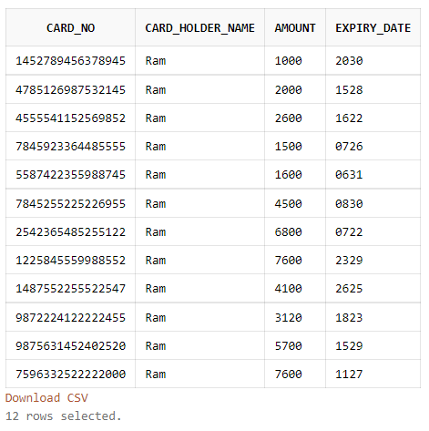
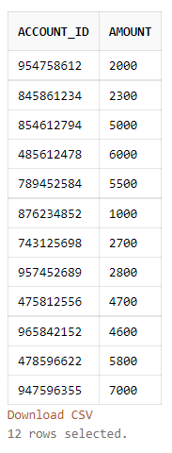
SQL
CardPayment Netbanking

Slide 40
SQL
Netbanking
create table Netbanking(Account_ID varchar(20) NOT NULL , Amount float NOT NULL ,PRIMARY KEY(Account_ID));
insert into Netbanking values('954758612','2000');
insert into Netbanking values('845861234','2300');
insert into Netbanking values('854612794','5000');
insert into Netbanking values('485612478','6000');
insert into Netbanking values('789452584','5500');
insert into Netbanking values('876234852','1000');
insert into Netbanking values('743125698','2700');
insert into Netbanking values('957452689','2800');
insert into Netbanking values('475812556','4700');
insert into Netbanking values('965842152','4600');
insert into Netbanking values('478596622','5800');
insert into Netbanking values('947596355','7000');

Slide 41
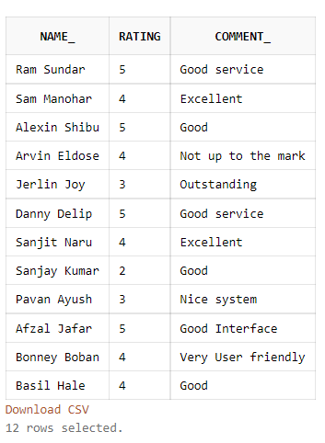
SQL
Feedback
create table Feedback(Name_ varchar(20), Rating number(10) ,Comment_ varchar(100));
insert into Feedback values('Ram Sundar','5','Good service');
insert into Feedback values('Sam Manohar','4','Excellent');
insert into Feedback values('Alexin Shibu','5','Good ');
insert into Feedback values('Arvin Eldose','4','Not up to the mark');
insert into Feedback values('Jerlin Joy','3','Outstanding');
insert into Feedback values('Danny Delip','5','Good service');
insert into Feedback values('Sanjit Naru','4','Excellent');
insert into Feedback values('Sanjay Kumar','2','Good ');
insert into Feedback values('Pavan Ayush','3','Nice system');
insert into Feedback values('Afzal Jafar','5','Good Interface');
insert into Feedback values('Bonney Boban','4','Very User friendly');
insert into Feedback values('Basil Hale','4','Good ');

Slide 42
UI DESIGN
Introduction to Tool(s):
Front end tools:
HTML5: a markup language used to build the basic structure of the UI. From the input tag to submission of the forms.
CSS3: a style sheet language used to make the UI design more approachable and aesthetically pleasing.
JavaScript: often abbreviated JS, is a programming language that is one of the core technologies of the World Wide Web, alongside HTML and CSS.
Database:
SQL: using the MySQL workbench, the data stored in the variables are stored in this database using a connection established by php.

Slide 43
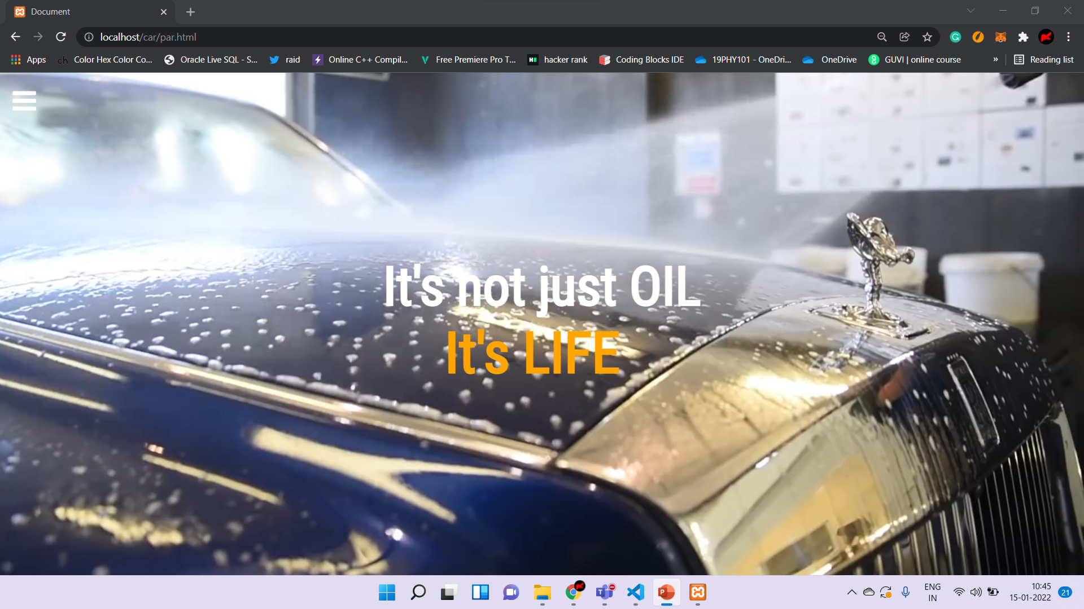

Slide 44
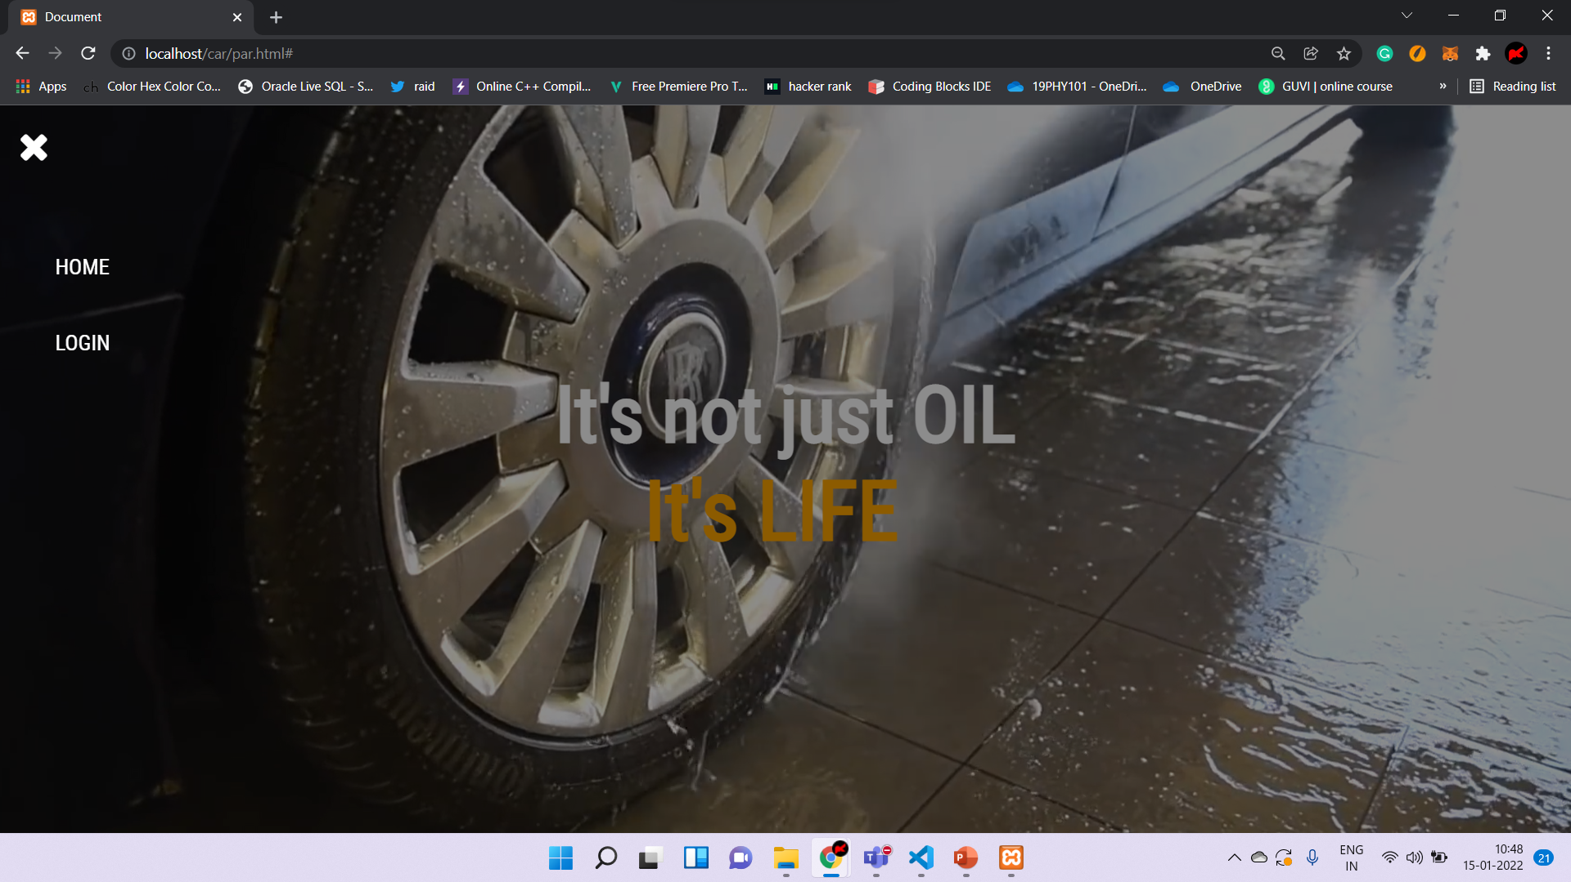

Slide 45
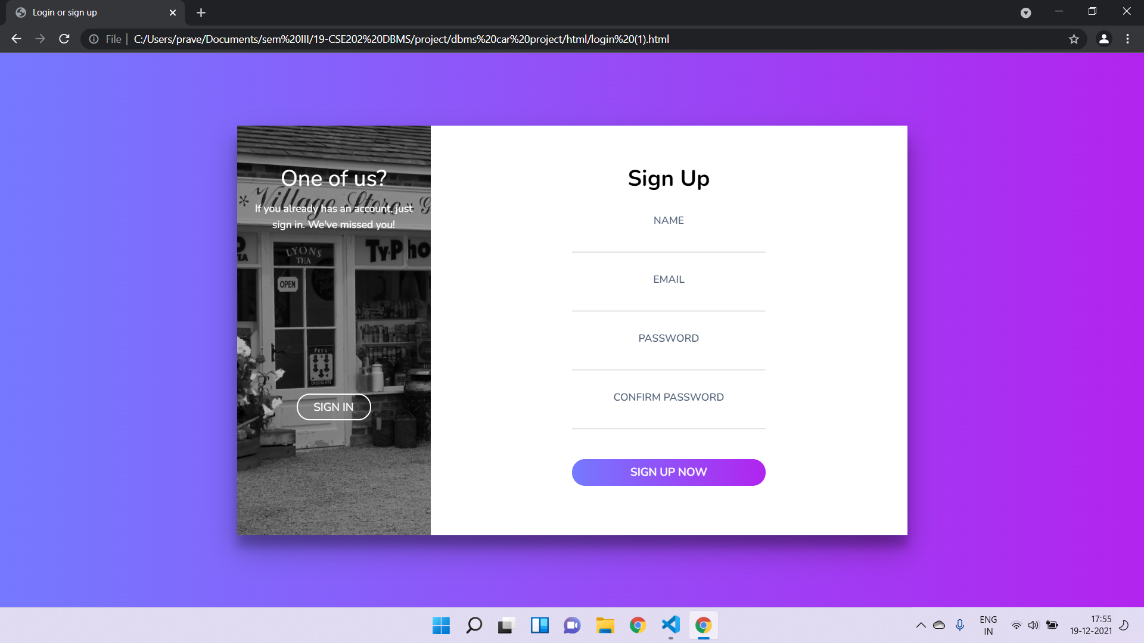
UI DESIGN

Slide 46
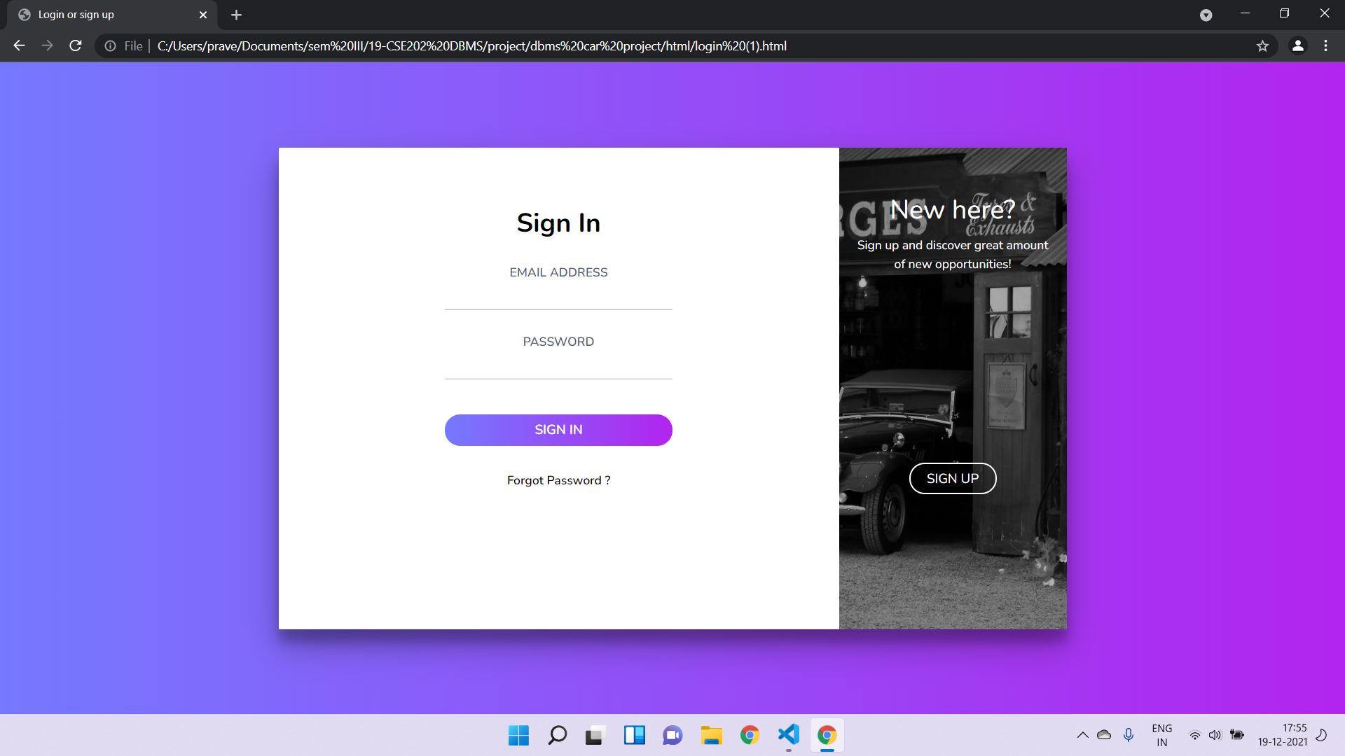
UI DESIGN

Slide 47
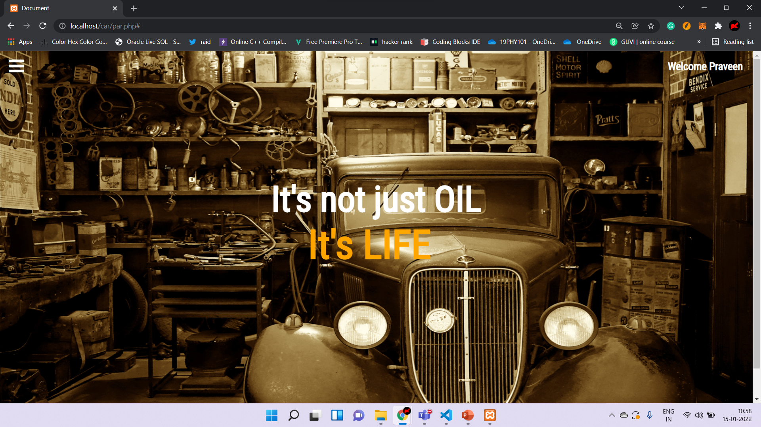
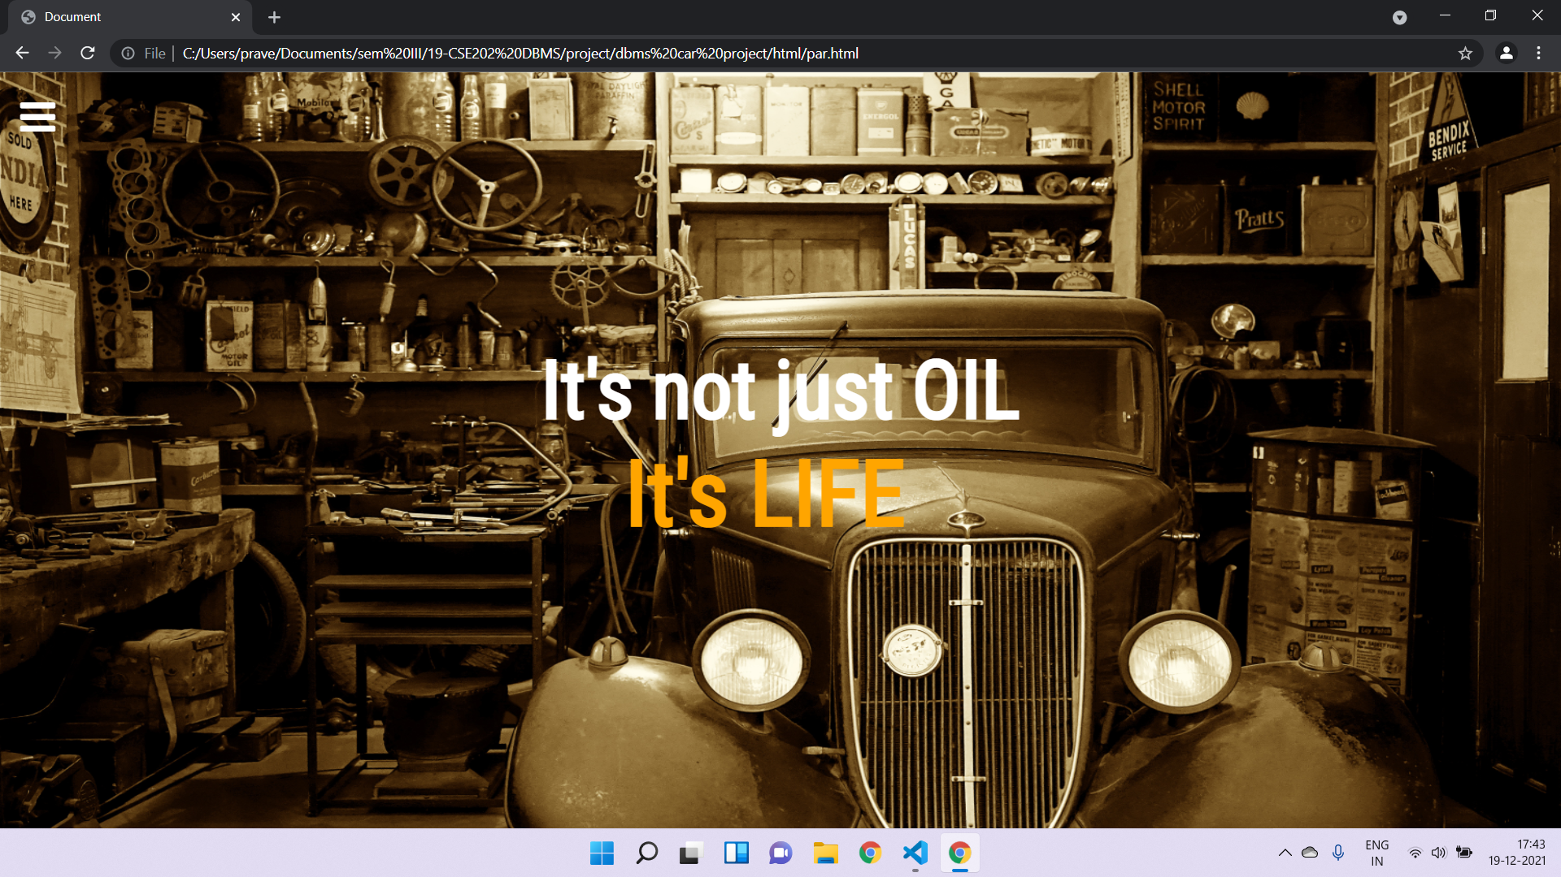
UI DESIGN

Slide 48
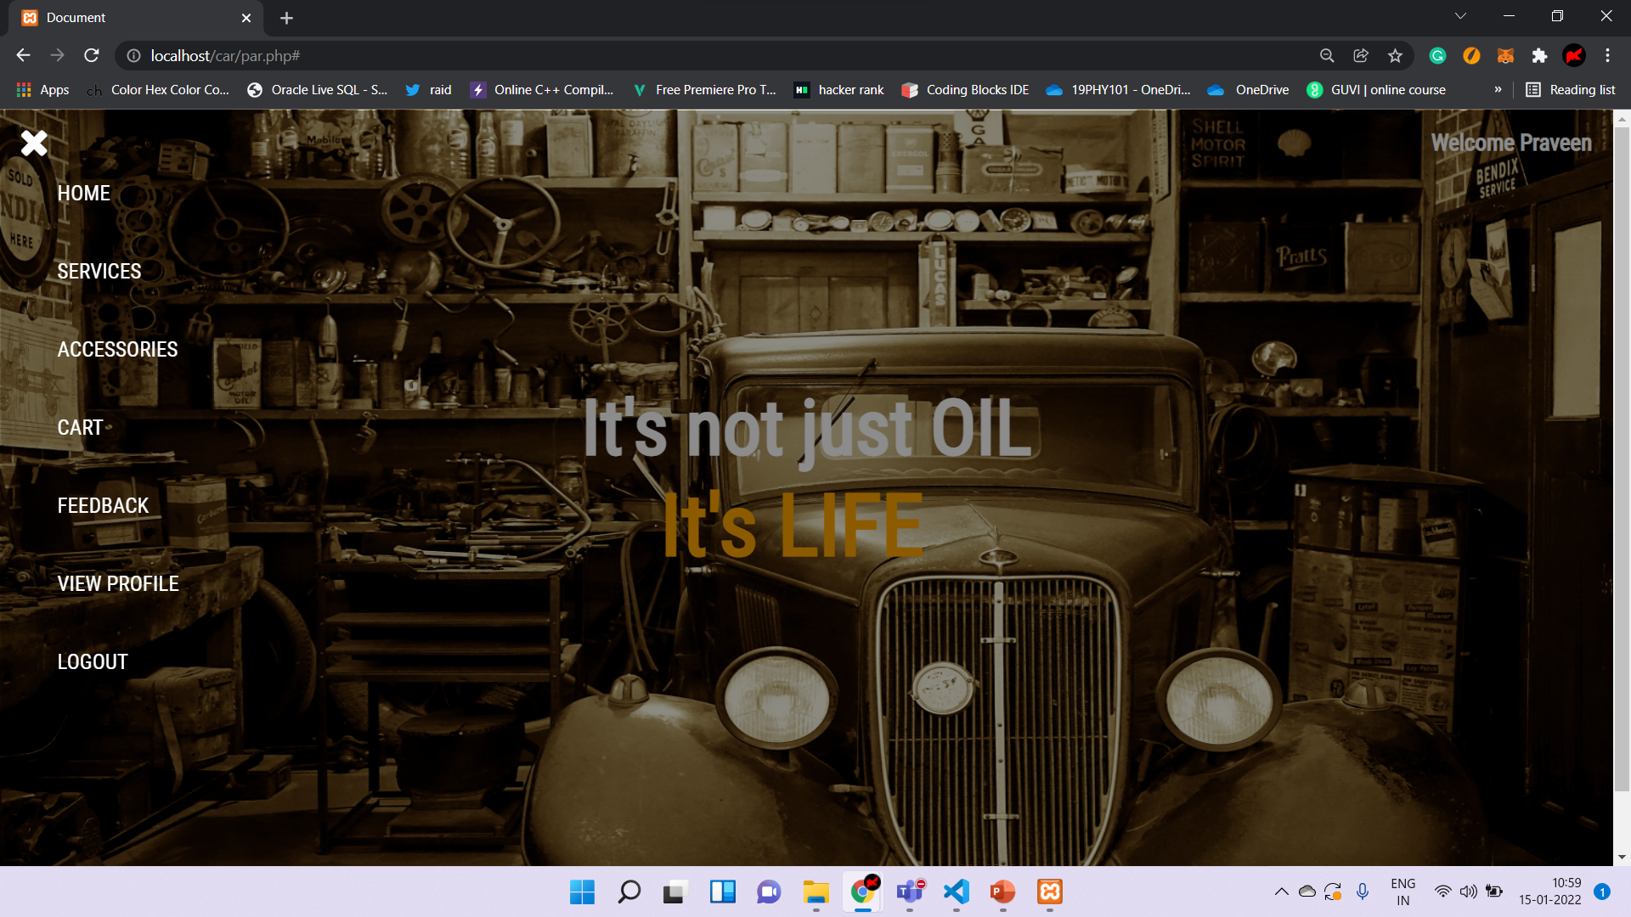

Slide 49
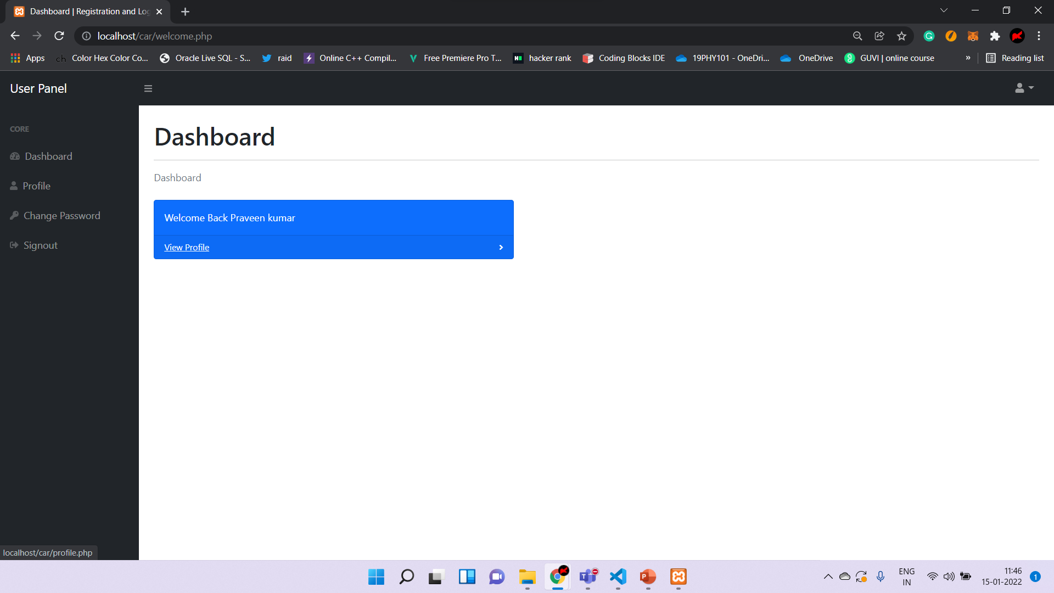

Slide 50
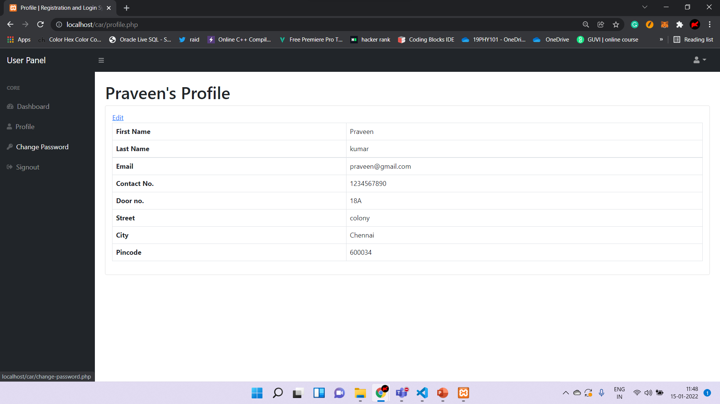

Slide 51
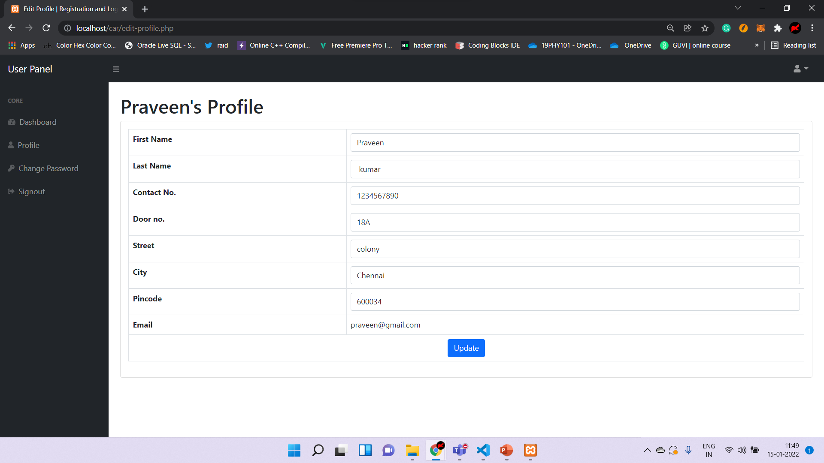

Slide 52
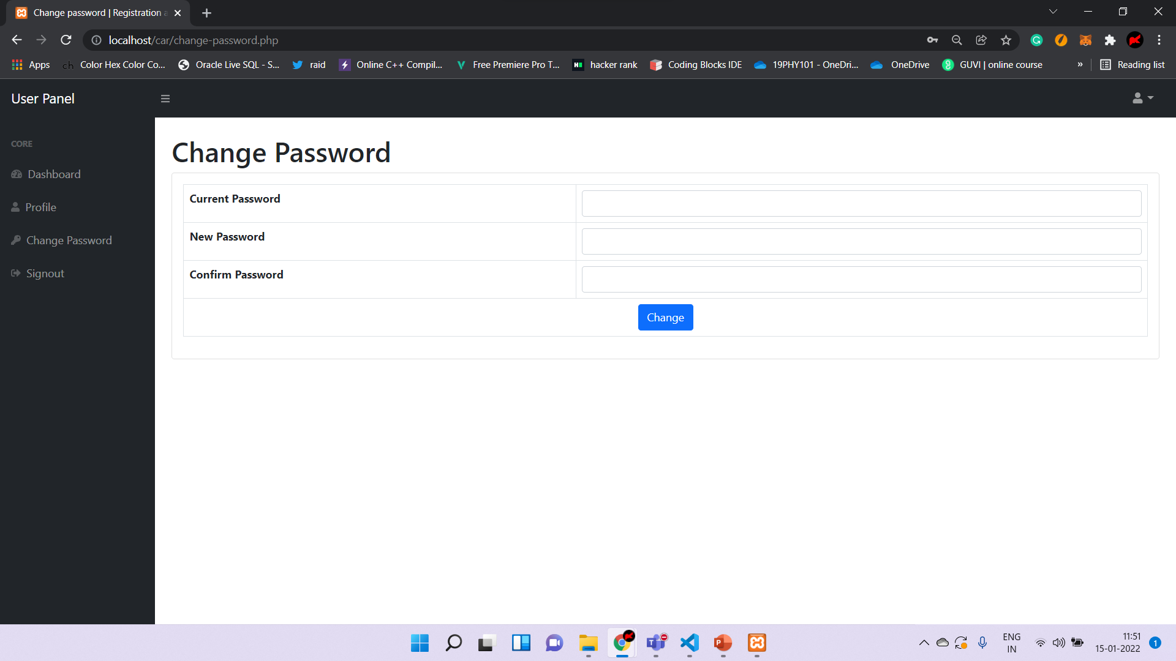

Slide 53
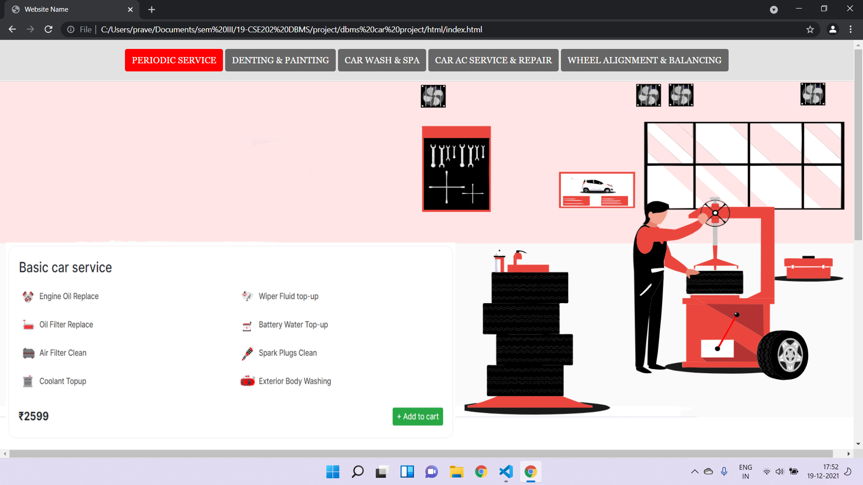
UI DESIGN

Slide 54
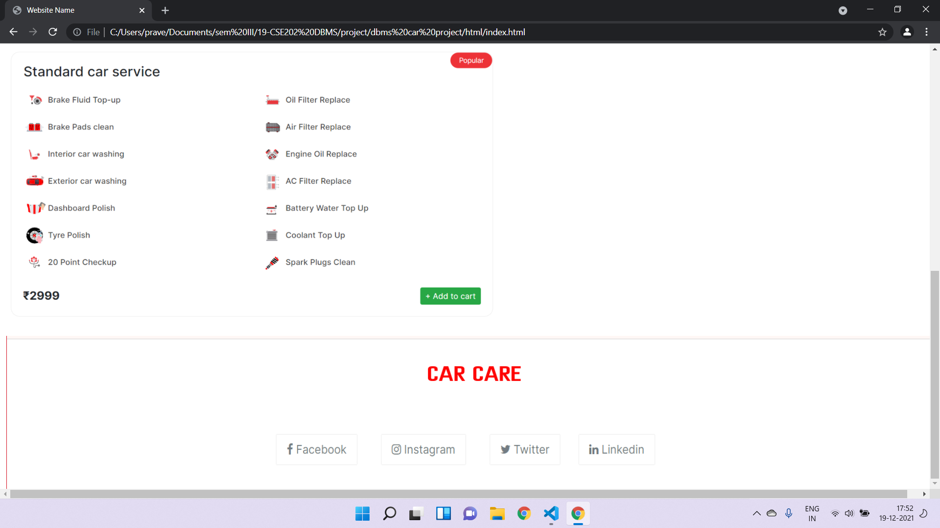
UI DESIGN

Slide 55
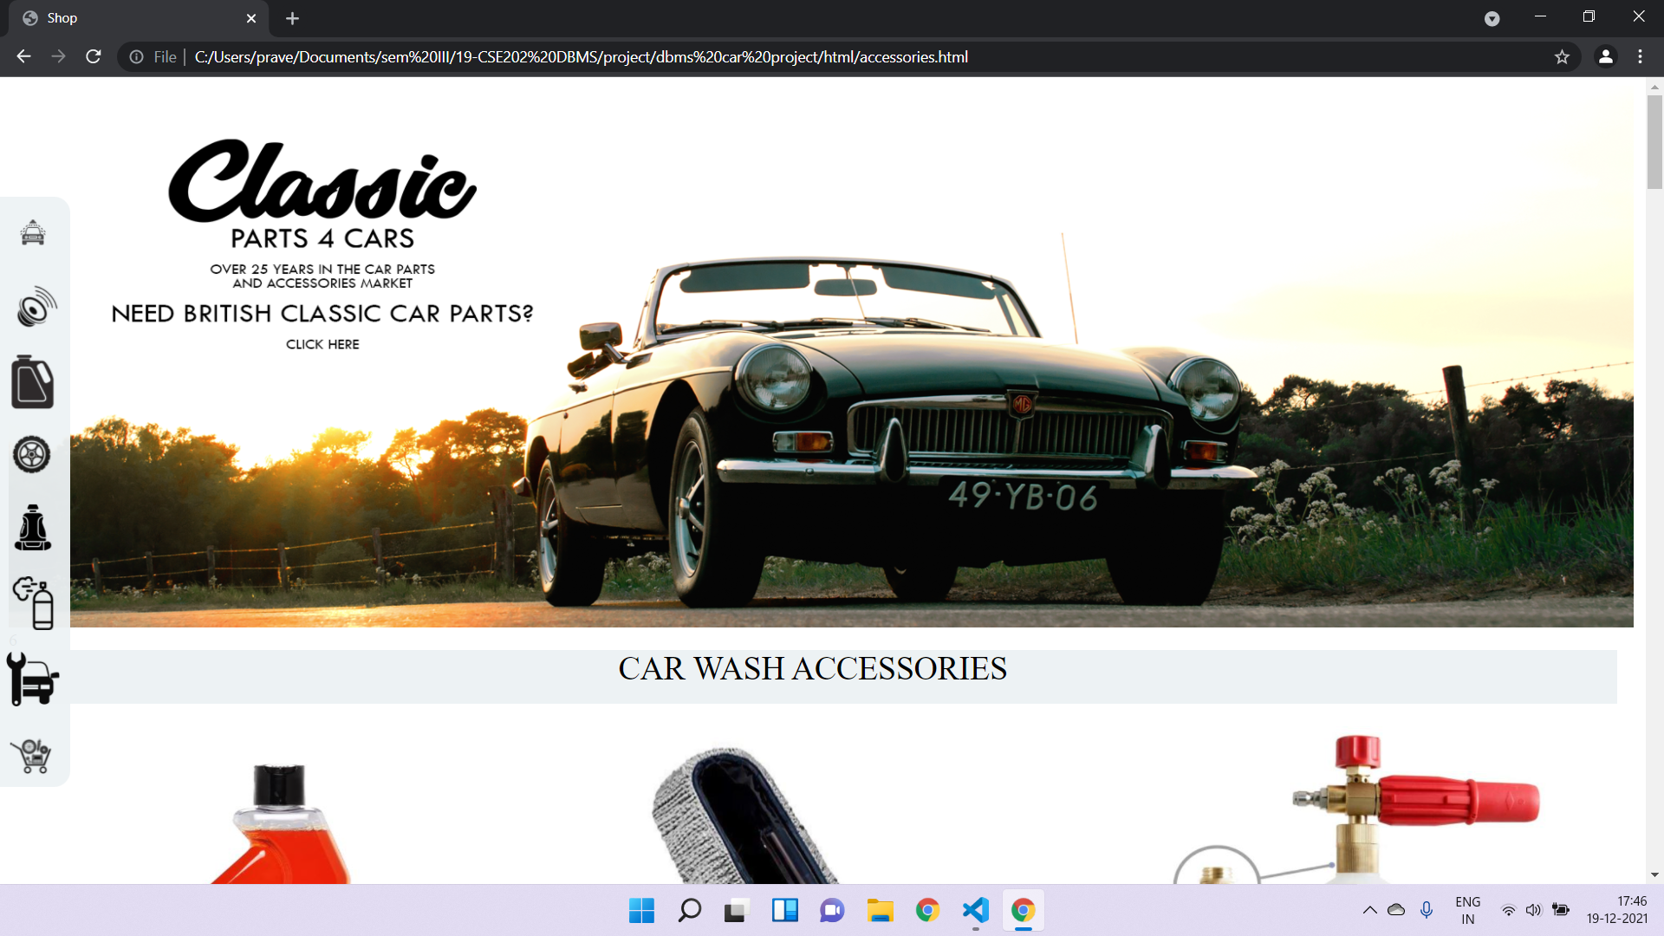
UI DESIGN

Slide 56
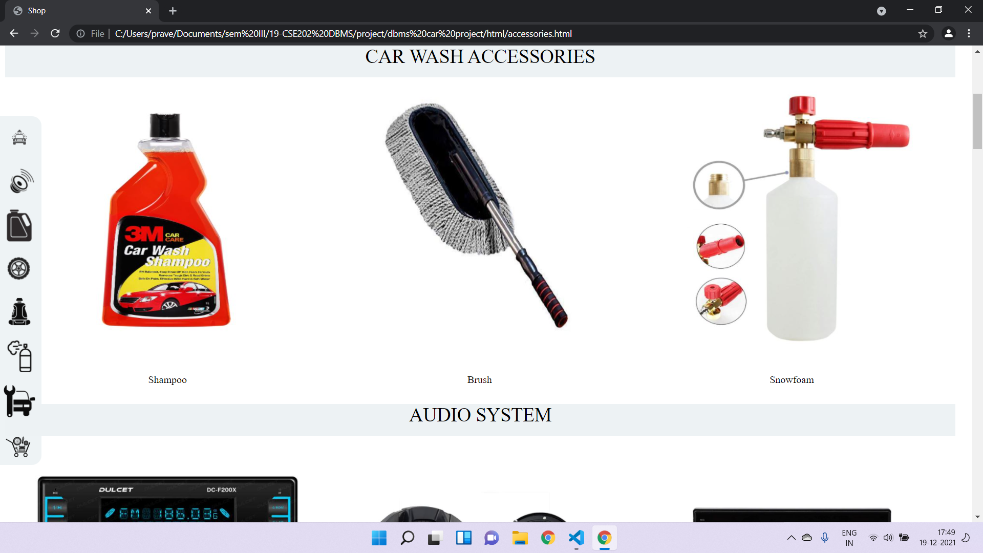
UI DESIGN

Slide 57
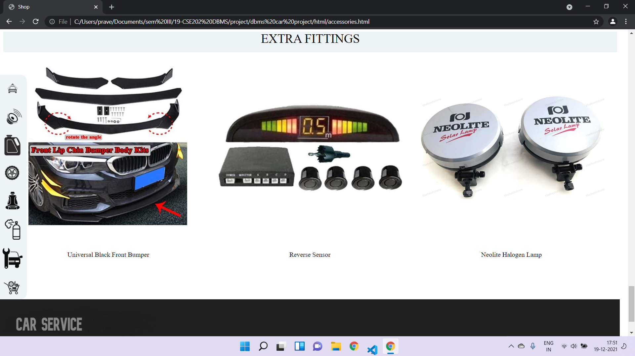
UI DESIGN

Slide 58
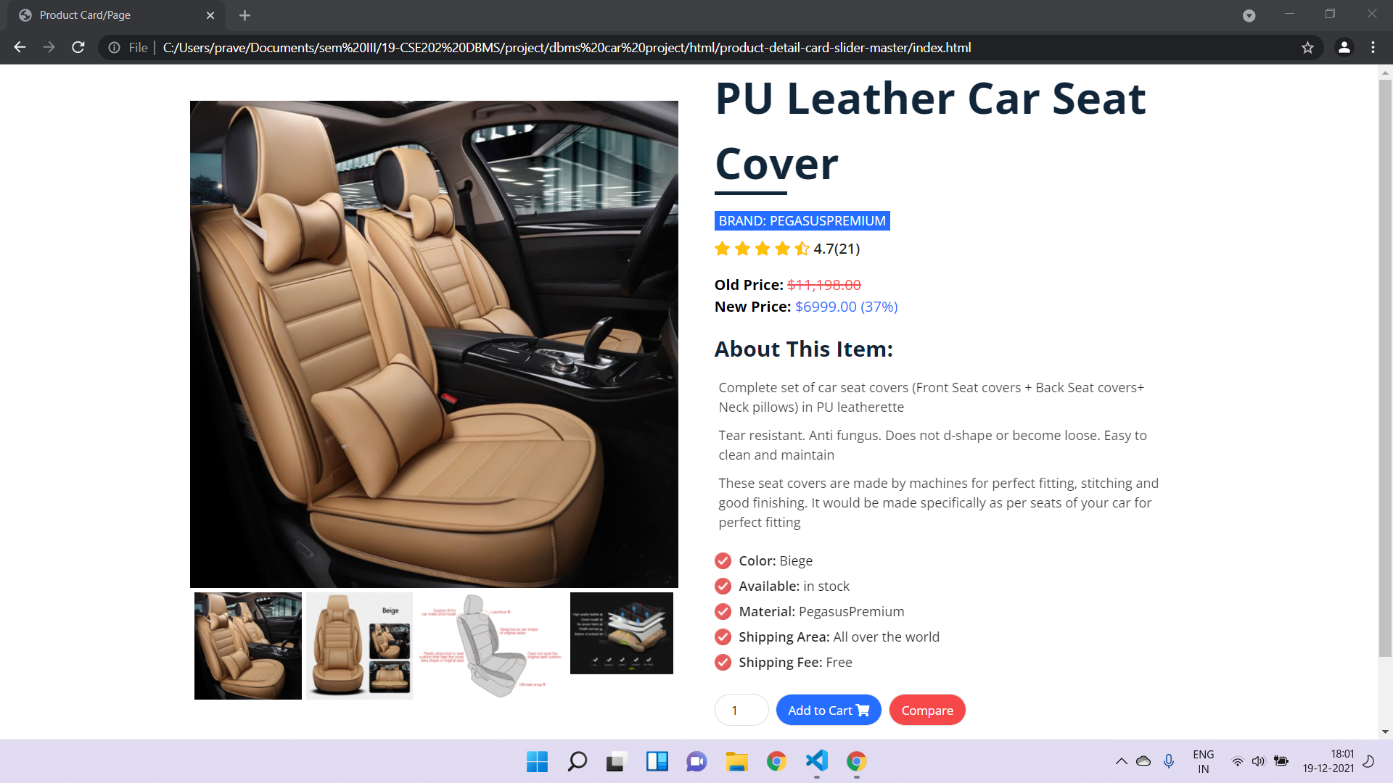
UI DESIGN

Slide 59
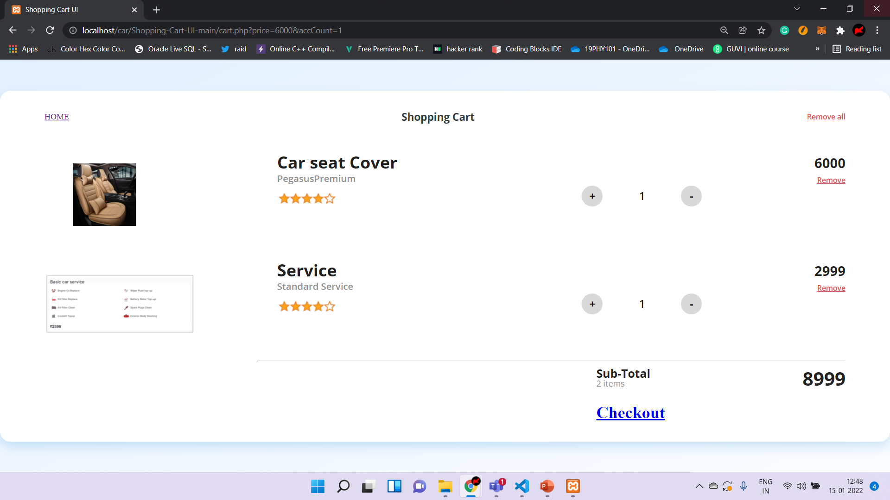

Slide 60
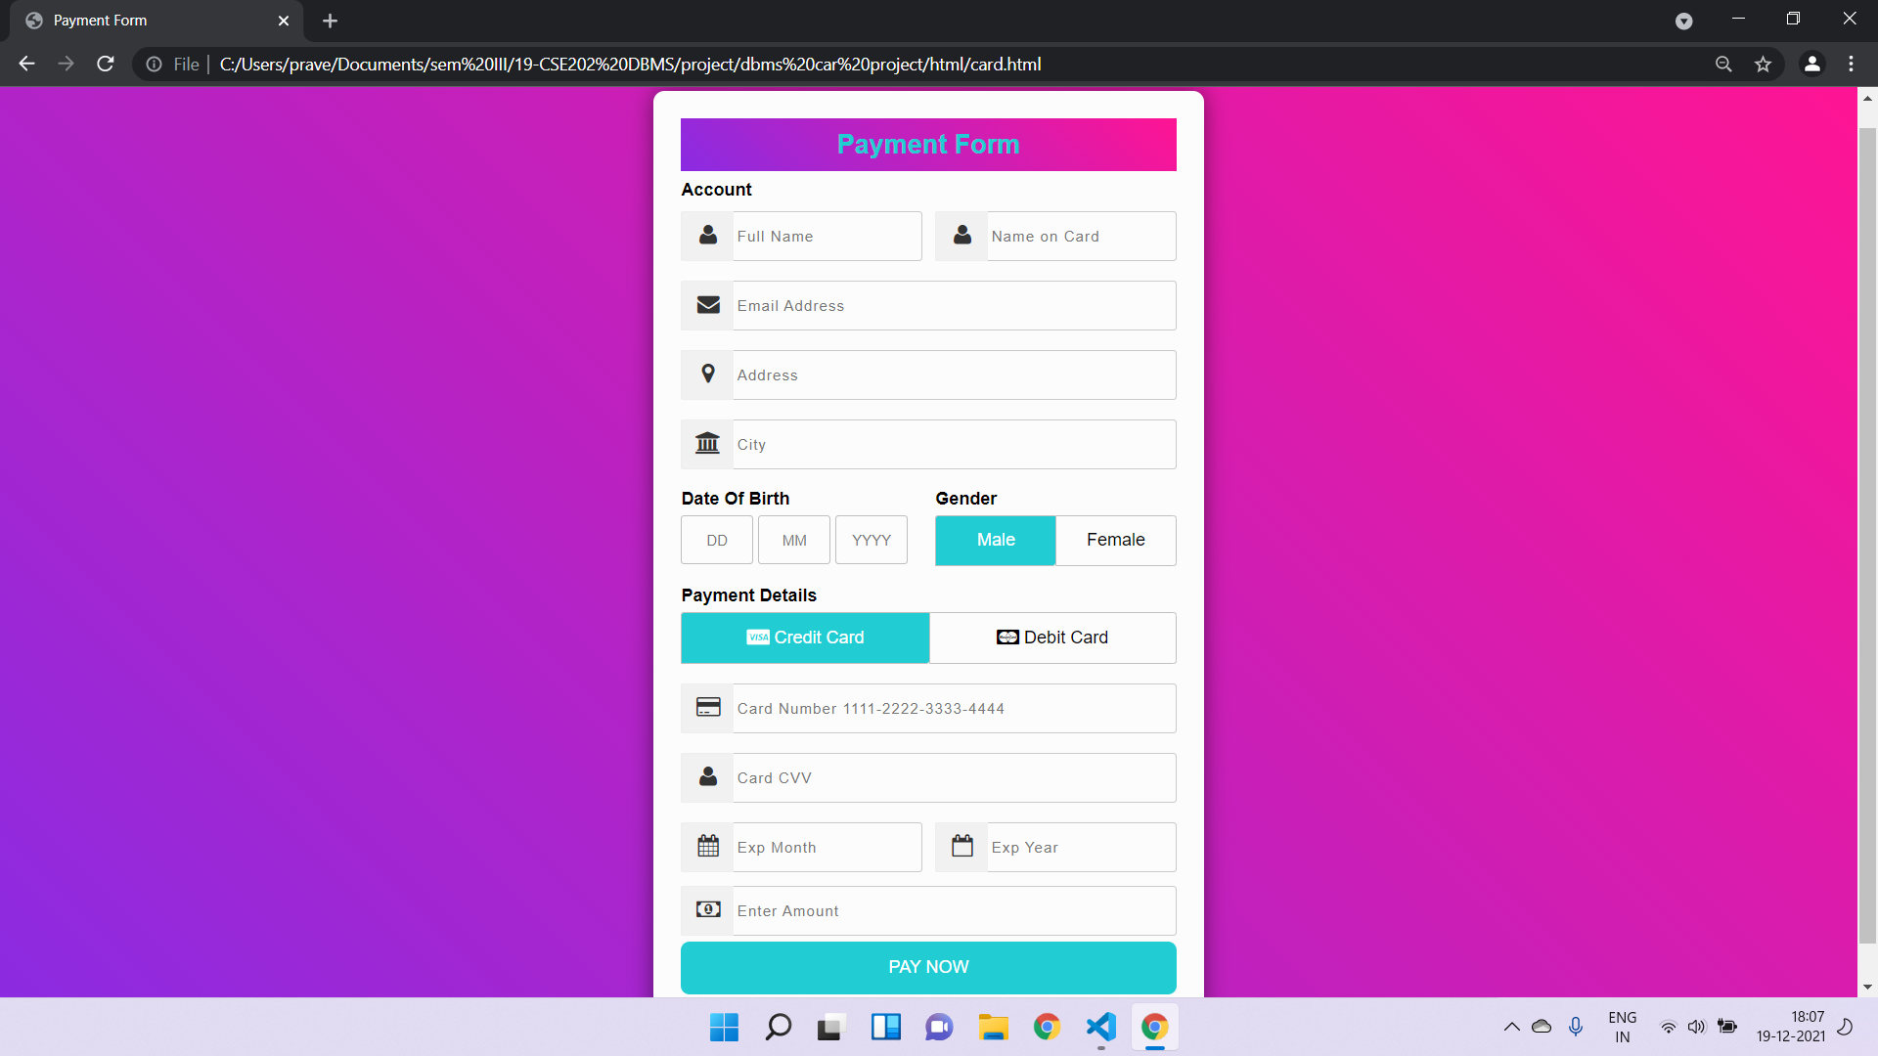
UI DESIGN

Slide 61
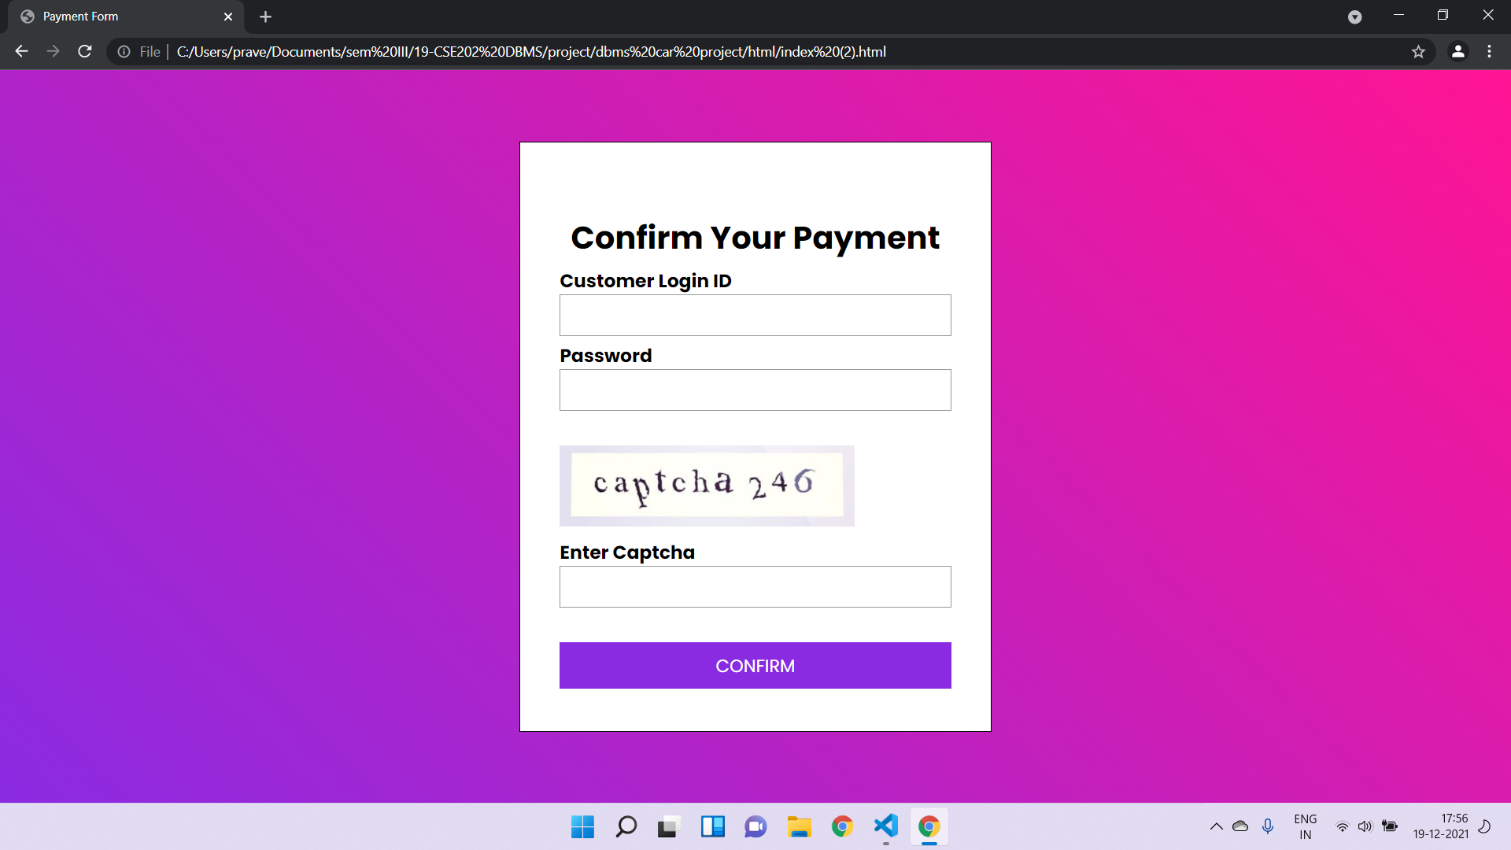
UI DESIGN

Slide 62
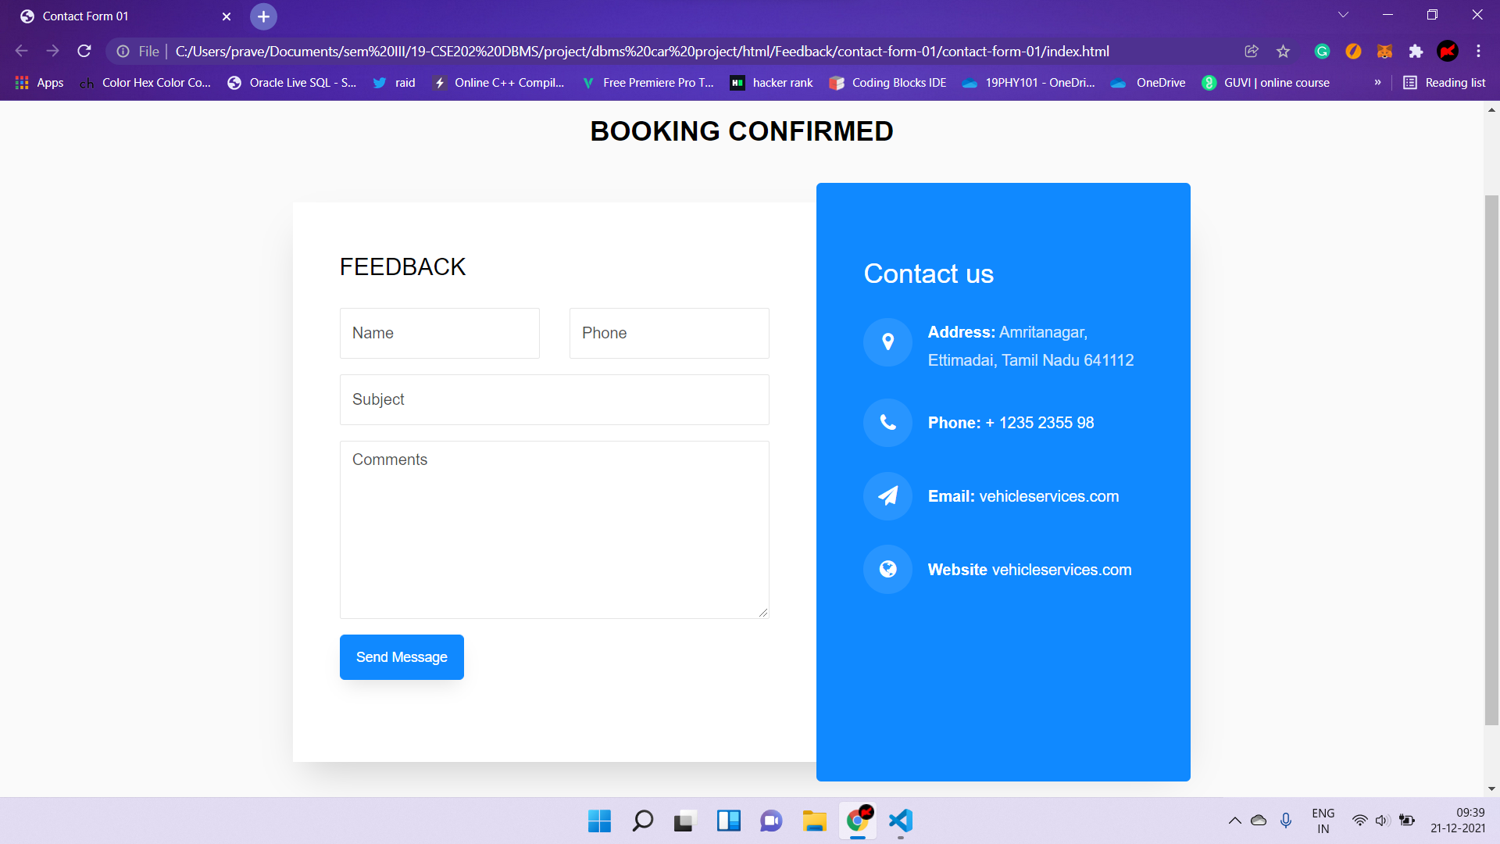
UI DESIGN

Slide 63
SAMPLE PHP CODE
<?php session_start();
include_once('connection.php');
{
if(isset($_POST['update'])){
$fname=$_POST['fname'];
$lname=$_POST['lname'];
$contact=$_POST['contact_id'];
$doorno=$_POST['doorno'];
$street=$_POST['street'];
$city=$_POST['city'];
$pin=$_POST['pin'];
$userid=$_SESSION['username'];
$msg=mysqli_query($con,"update customer_name set f_name='$fname',l_name='$lname'where email_id='$userid'");
$msg1=mysqli_query($con, "update ph_no set ph_no = '$contact' where email_id = '$userid'");
$msg2=mysqli_query($con, "update customer_address set door_no = '$doorno',street = '$street',city = '$city',pincode = '$pin' where customer_id = '$userid'");
if($msg && $msg1 && $msg2){
echo "<script>alert('Profile updated successfully');</script>";
echo "<script type='text/javascript'> document.location = 'profile.php'; </script>";
}
}

Slide 64
?>
<!DOCTYPE html>
<html lang="en">
<head>
<meta charset="utf-8" />
<meta http-equiv="X-UA-Compatible" content="IE=edge" />
<meta name="viewport" content="width=device-width, initial-scale=1, shrink-to-fit=no" />
<meta name="description" content="" />
<meta name="author" content="" />
<title>Edit Profile | Registration and Login System</title>
<link href="https://cdn.jsdelivr.net/npm/simple-datatables@latest/dist/style.css" rel="stylesheet" />
<link href="css/styles.css" rel="stylesheet" />
<script src="https://cdnjs.cloudflare.com/ajax/libs/font-awesome/5.15.3/js/all.min.js" crossorigin="anonymous"></script>
</head>
<body class="sb-nav-fixed">
<?php include_once('includes/navbar.php');?>
<div id="layoutSidenav">
<?php include_once('includes/sidebar.php');?>
<div id="layoutSidenav_content">
<main>
<div class="container-fluid px-4">

Slide 65
<?php
$userid=$_SESSION['username'];
$query=mysqli_query($con,"select * from Customer_name where email_id='$userid'");
$query1=mysqli_query($con,"select * from ph_no where email_id='$userid'");
$query2=mysqli_query($con,"select * from customer_address where customer_id='$userid'");
$result1=mysqli_fetch_array($query1);
$result2=mysqli_fetch_array($query2);
while($result=mysqli_fetch_array($query))
{?>
<h1 class="mt-4"><?php echo $result[1];?>'s Profile</h1>
<div class="card mb-4">
<form method="post">
<div class="card-body">
<table class="table table-bordered">
<tr>
<th>First Name</th>
<td><input class="form-control" id="fname" name="fname" type="text" value="<?php echo $result[1];?>" required /></td>
</tr>
<tr>
<th>Last Name</th>
<td><input class="form-control" id="lname" name="lname" type="text" value="<?php echo $result[2];?>" required /></td>
</tr>

Slide 66
<tr>
<th>Contact No.</th>
<td colspan="3"><input class="form-control" id="contact" name="contact_id" type="text" value="<?php echo $result1[1];?>" pattern="[0-9]{10}" title="10 numeric characters only" maxlength="10" required /></td>
</tr>
<tr>
<th>Door no.</th>
<td><input class="form-control" id="lname" name="doorno" type="text" value="<?php echo $result2[2];?>" required /></td>
</tr>
<tr>
<th>Street</th>
<td><input class="form-control" id="lname" name="street" type="text" value="<?php echo $result2[3];?>" required /></td>
</tr>
<tr>
<th>City</th>
<td><input class="form-control" id="lname" name="city" type="text" value="<?php echo $result2[4];?>" required /></td>
</tr>

Slide 67
<tr>
<th>Pincode</th>
<td><input class="form-control" id="lname" name="pin" type="text" value="<?php echo $result2[1];?>" required /></td>
</tr>
<tr>
<th>Email</th>
<td colspan="3"><?php echo $result[0];?></td>
</tr>
<tr>
<td colspan="4" style="text-align:center ;"><button type="submit" class="btn btn-primary btn-block" name="update">Update</button></td>
</tr>
</tbody>
</table>
</div>
</form>
</div>
<?php } ?>
<?php } ?>

Slide 68


